Slide 1
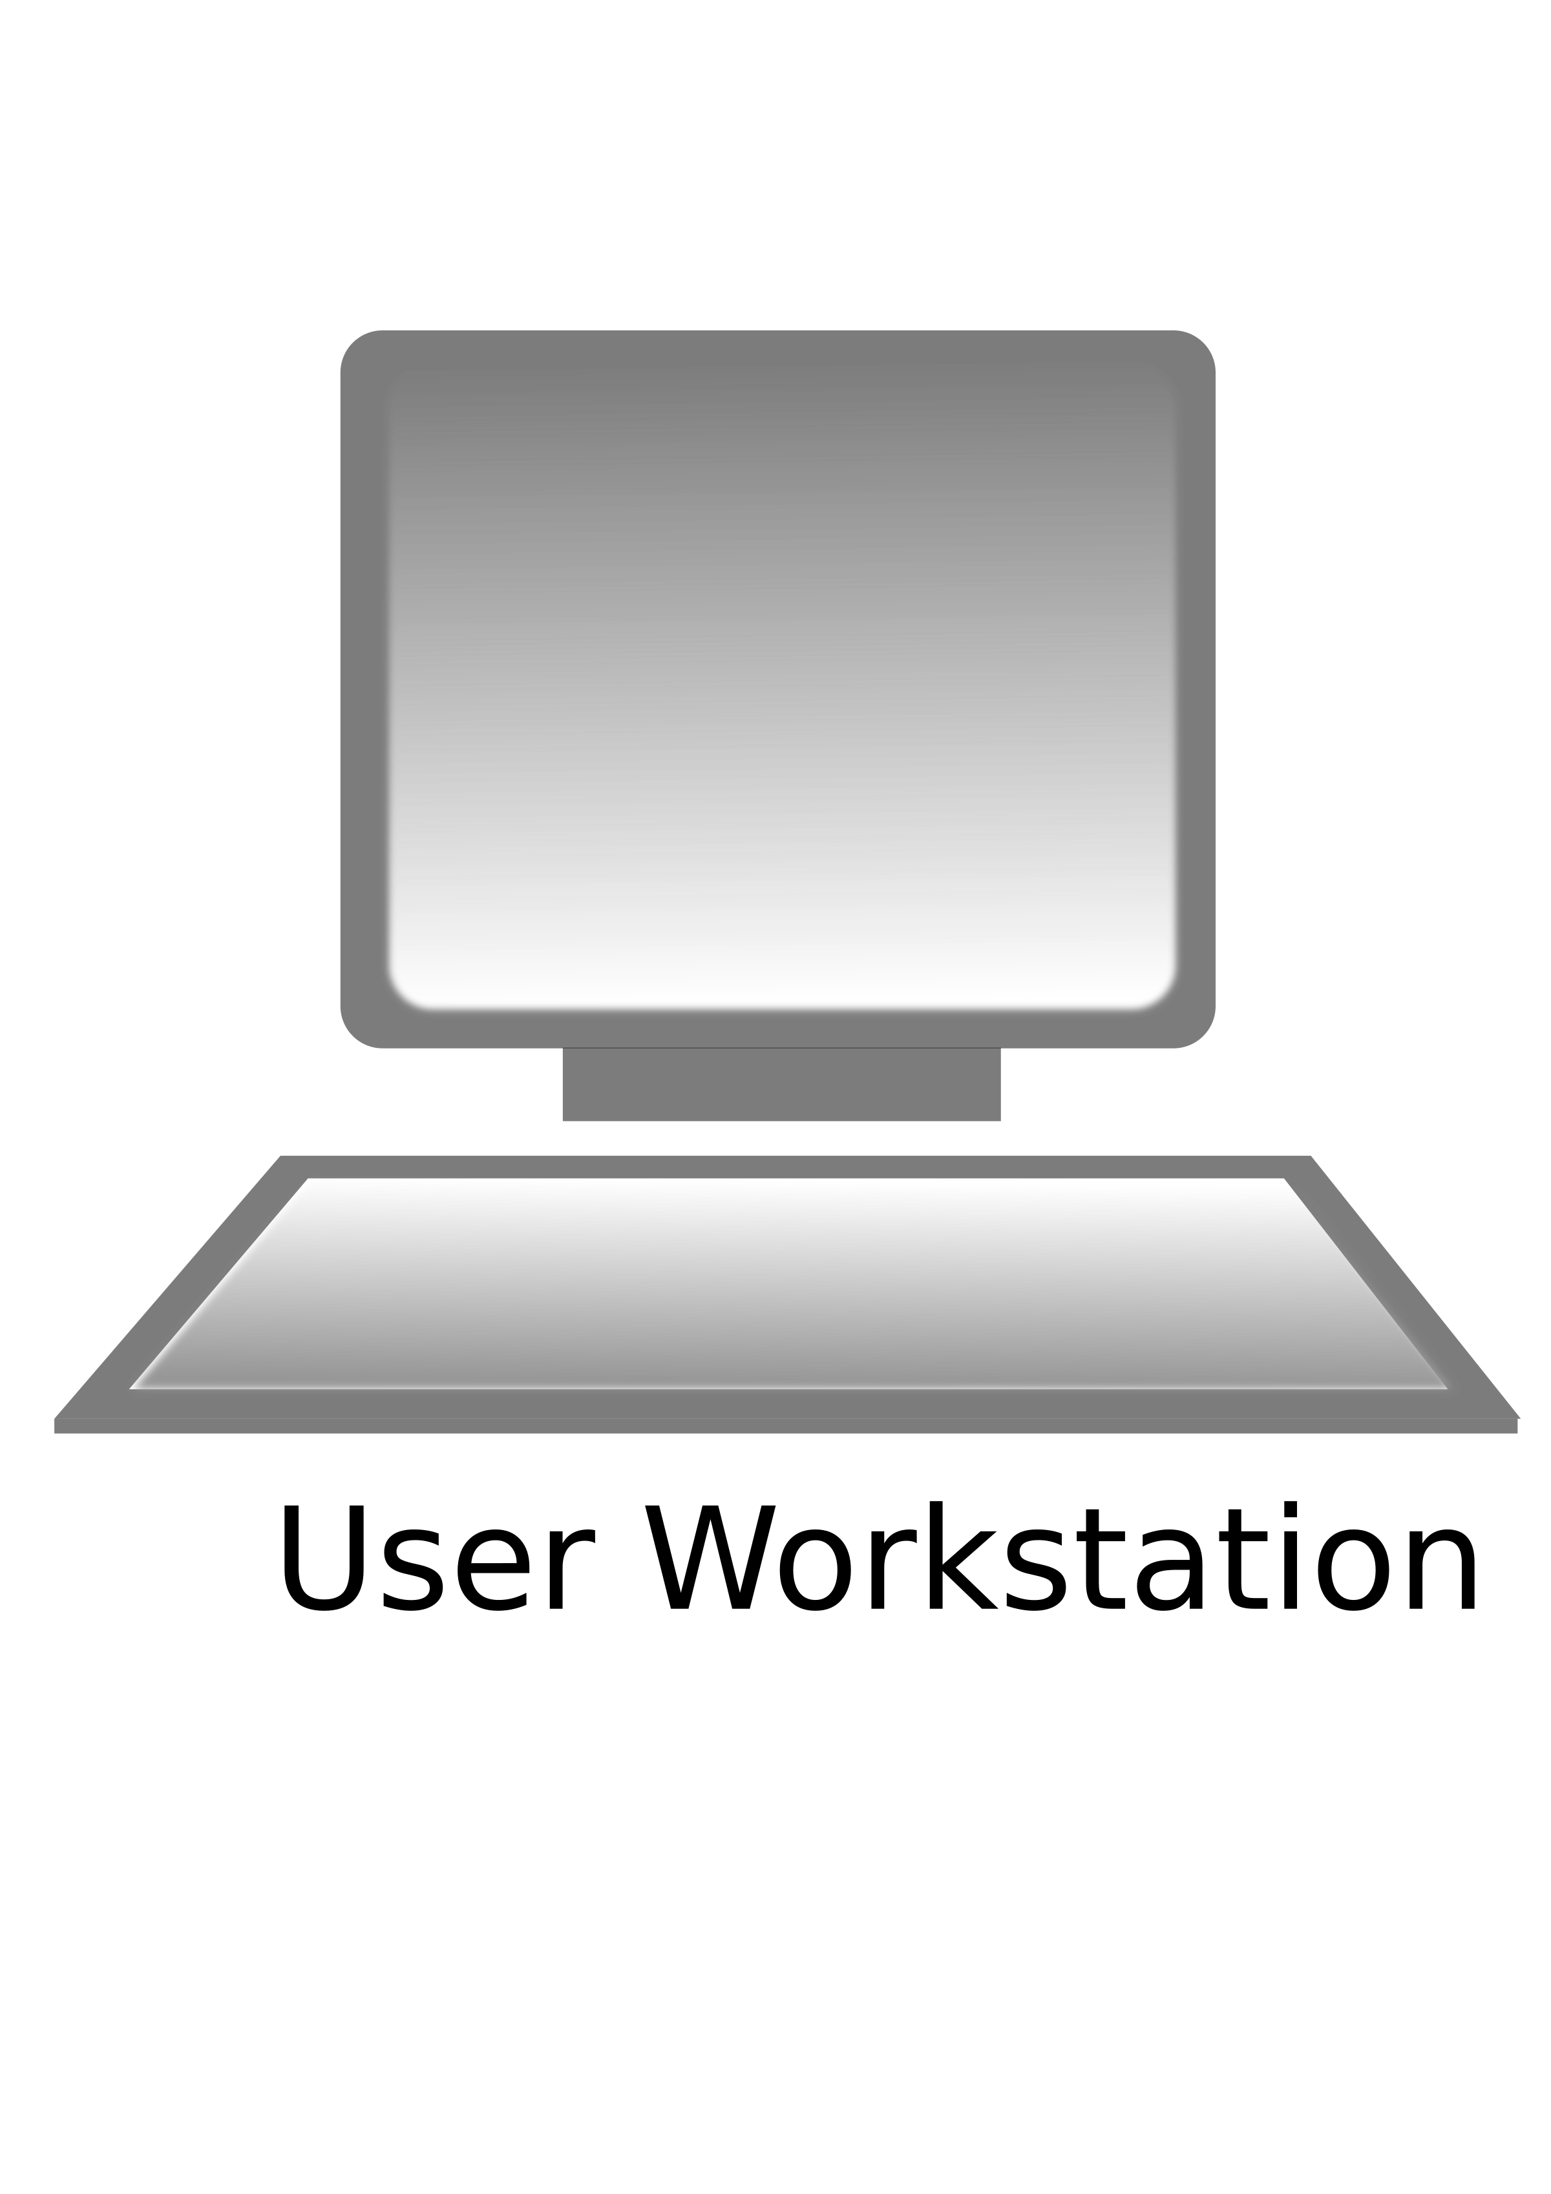


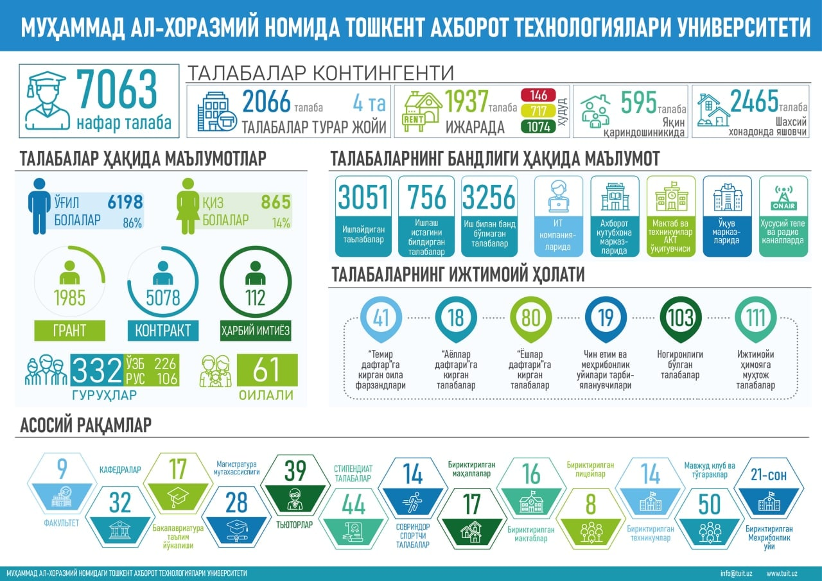



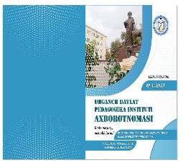




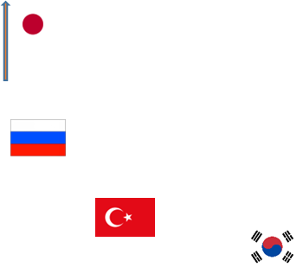
INFOGRAPHIC ON TARGET INDICATORS IMPLEMENTED IN THE FIRST HALF OF 2023
Area – 3,66 thousand square km Power– 1850 places
On scientific potential
Number of buildings 3
DYNAMICS OF ACCESS TO HIGHER EDUCATION
Doctor of sciences 12
Number of classrooms 92
Candidates of science 13
According to the 2022-2023 admission quota
2,2 times increase
1815
Main teachers 13
Total number of students 826
Bachelor 475
Distance learning 300
Masters 51
Teacher– intern teachers 23
826
Defendable Doctor of Philosophy Dissertations (PhD)
Number of students
2023
2022
Amount of increase
1,25 times
2022 -2023y.
According to end of the year.
Defended Doctoral Dissertations (DSc)
The level of provision of educational literature
2023
2022
Amount of increase
1 times
INDICATORS ON WORK WITH YOUTH AND SPIRITUAL-EDUCATIONAL ACTIVITY
43
15
1720
Employed students
Students wanting to work
Unemployed students
In IT companies
In Learning Resource Centers
School and technical school ICT teachers
Learning centers
On private television and radio channels
Parameters of the academic lyceum to be established in the presence of the Urganch State Pedagogical Institute in 2023-2026
SOCIAL STATUS OF STUDENTS
From the 2023-2024 academic year, admission will be carried out in the following directions.
Located in Urgench city on Yoshlik street.
The land area is 1.85 ha.
Power is 360 seats
To “Temir Daftar".
entered family
children
To ”Ayollar daftari”
Entered students
To “Yoshlar daftar”entered students
Children of real orphans and orphanages
Students with disabilities
Students in need of social protection
7
3
8
8
29
14
Exact sciences
Mathematics
Native Language
26
Foreign Languages
Foreign language
Native language
52
Socio-humanitarian
History
Foreign language
26
Main numbers
Tutors
Departments
Faculties
Bachelor courses
Masters courses
2
5
11
7
7
Prize-winning student athletes
The number of connected lyceums
Available clubs and activities
12
1
12
Urgench State Pedagogical Institute Material and technical base
Solar panels with a capacity of 100 kWh and a value of 839.4 million soums were installed in the buildings of the institute.
Information on scientific and innovative activities
A total of 60 Monoblocks worth 510,000,000 soums were purchased in order to increase the efficiency of the staff and LRC of the Urgench State Pedagogical Institute.
CERTIFICATE No. 064130, registered at the Information and Mass Communications Agency under the Administration of the President of the Republic of Uzbekistan on February 17, 2023. ISSN/2992-8796 Scientific-theoretical, methodical magazine was created.
A total of 8 televisions worth 25.5 million soums were purchased for the demonstration of spiritual and educational activities of the institute, and a total of 8 interactive touch panels worth 215.2 million soums were purchased to increase the effectiveness of classes.
2 Servers worth 253,911,600 soums were purchased in order to create the official website of the institute, MODUL, HEMIS system and student database.
Cooperation with reputable HEIs
Cooperation with reputable HEIs
Korea
Russia
Azerbaijan
Turkey
Indonesia
VISIT OF FOREIGN SCIENTISTS TO THE INSTITUTE
(at least for 1 month)
(4 times)
Web of Science | 1 | -
Scopus | - | -
In impact-factor journals | 11 | 20
International journals | 31 | 42
International conferences | 46 | 80
Republic conferences | 35 | 45
Republic journals | 45 | 55
Local journals | - | 2
Monograph | 8 | 6
Study manual | 15 | 13
Educational and methodological manual | 9 | 15
Textbook | 13 | 6
Total: | 2022 year | 2023 year
Cooperation with regional secondary and primary schools
6 schools and private
19 non-governmental primary and 19 special secondary schools

